Slide 1
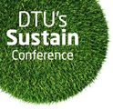
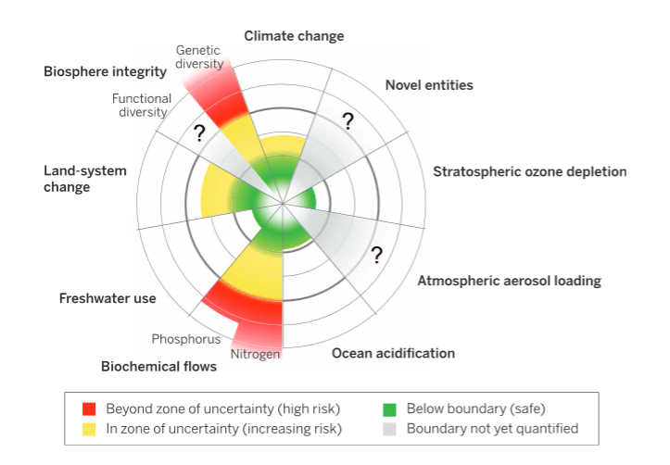
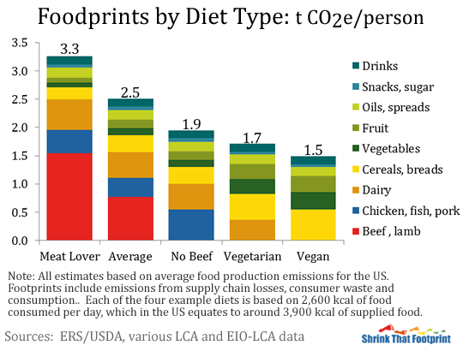
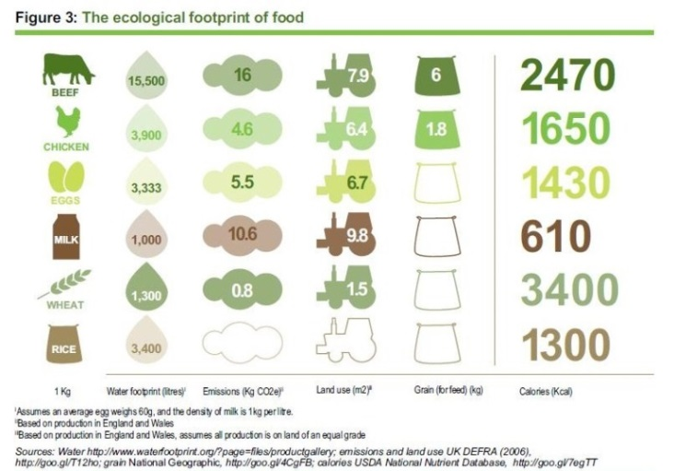
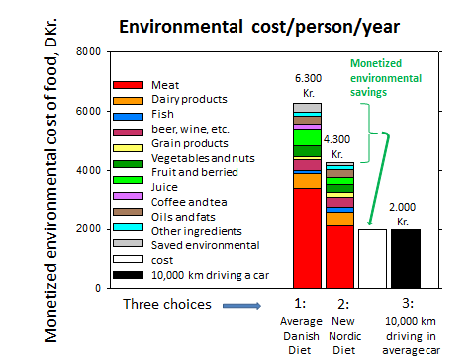
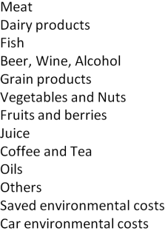
What is your foo print?
Planetary boundaries: Guiding human development on a changing planet. Science, Feb. 2015. http://www.sciencemag.org/content/347/6223/1259855
How does your diet choice influence your food footprint?
Services: restaurants,
leisure, insurance, etc.
On the planetary scale, a wide range of important aspects of a sustainable human activtiy are strongly influenced by our food supply. Biodiversity and the nitrogen and phosphorous cycles are pushed beyond the currently estimated safe limits of sustainability. We are in danger of losing control of land transformation, fresh water supply and climate change. Particulate pollution is another factor reponsible for more human health problems and causing more deaths than any other single environmen-tal problem. All are key aspects of food production.
Analyzing the overall environmental impact of an ‘average Dane’ it becomes clear that food consumption is the major contributor to the individual’s private impacts on the environment.
But we have to eat, but luckily your diet choice has major influence on your footprint. Our diet choice was the neglected point on the recent COP21 meeting in Paris – the forgotten tool in the toolbox for an envi-ronmental sustainable future – and a low-hanging fruit. Each of us can contribute.
Looking at food production in a global warming perspec-tive, it is clear that animal produce in general – and red meat in particular (e.g. beef) – is responsible for the unnecessarily high environmental impact of our diets. The impact from each type of food varies considerably in terms of land use, CO₂, water consumption etc.
A convincing analogy to car transportation shows that a diet-shift from the “Average Danish Diet” to the so called “New Nordic Diet” with 35 % less meat will reduce the monetized annual environmental impact of your diet as much as driving 10.000 km less per year in your ‘average Danish’ car.
Waste less food, and consume less meat will considerably decrease your ‘foodprint’ and you neither have to go vegetarian nor vegan ☺
Shopping: clothes, shoes, electronics etc.
Transport in car,
plane, and cargo
Food and drink
Housing: energy, main-tenance, furniture…
Kristian Mølhave (Nanotech) and Henrik Saxe (Man. Eng./GDSI)
From http://www.eoi.es/blogs/martagomezmanchon/2014/02/28/how-can-we-face-the-sustainable-food-production-challenge/
ajcn.nutrition.org/content/99/5/1117

